Slide 1
Week 4b
COMPUTATIONAL MATHEMATICS

Slide 2

Session Learning Outcomes
Upon completion of this session, you should be able to solve linear algebra problems: $A x = b$ by both manually and using Python

Slide 3
Reference
Kisualaas, Jann. (2013). Numerical Methods in Engineering with Python 3. Cambridge University Press.
Johansson, Robert. (2015). Chapter 5. Equation Solving. Numerical Python: A Practical Techniques Approach for Industry, Apress.
Chapra, S. C., and Raymond P. Canale. (2010). Numerical methods for engineers, Sixth edition, McGraw Hill.

Slide 4
Topics to be covered
Python matrix and vector
Determinant
Matrix Inversion
Solving Linear System

Slide 5
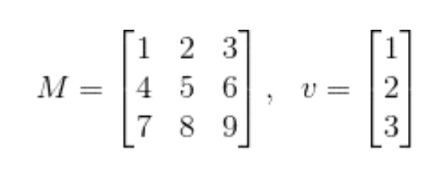
Matrices and Vectors (in Python)
import numpy as np
M = np.array([[1, 2, 3],
[4, 5, 6],
[7, 8, 9]])
v = np.array([[1],
[2],
[3]])

Slide 6
Matrices and Vectors (in Python)
print M.shape # it returns (3, 3)
print v.shape # it returns (3, 1)
v_single_dim = np.array([1, 2, 3])
print v_single_dim.shape # it returns (3,)

Slide 7
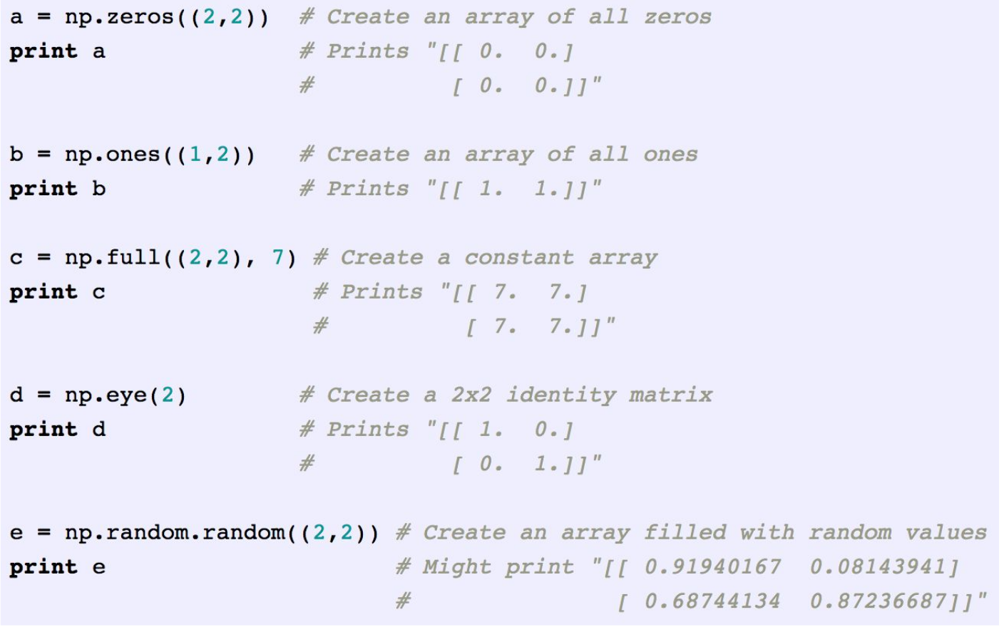
Other Ways to Create Matrices and Vectors
NumPy provides many convenience functions for creating matrices/vectors.

Slide 8
Other Ways to Create Matrices and Vectors
v1 = np.array([1, 2, 3])
v2 = np.array([4, 5, 6])
v3 = np.array([7, 8, 9])
M = np.vstack([v1, v2, v3])
print M
#Output: [[1 2 3]
[4 5 6]
[7 8 9]]

Slide 9
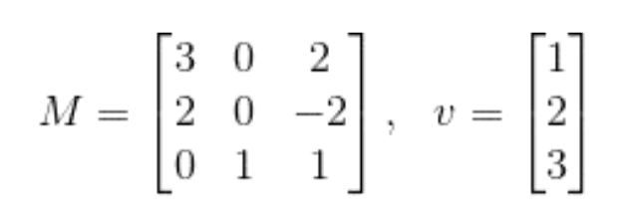
Basic Operations - Dot Multiplication
print M.dot(v)
#output: [[ 9]
[-4]
[ 5]]

Slide 10
Basic Operations - Element-wise Multiplication
print np.multiply(M, v)
#Output: [[ 3 0 2]
[ 4 0 -4]
[ 0 3 3]]
print np.multiply(v, v)
#Output: [[1]
[4]
[9]]

Slide 11
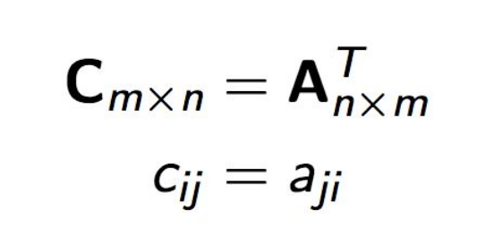
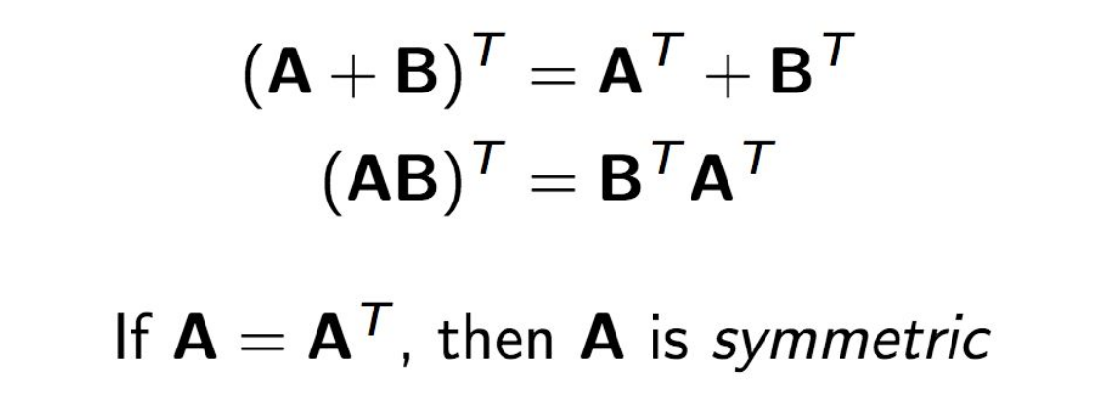
Basic Operations - Transpose
Definition
Identities

Slide 12
Basic Operations - Transpose
print M.T
#Output: [[1 4 7]
[2 5 8]
[3 6 9]]
print v.T
#Output: [[1 2 3]]
print M.T.shape, v.T.shape
#Output: (3, 3) (1, 3)

Slide 13
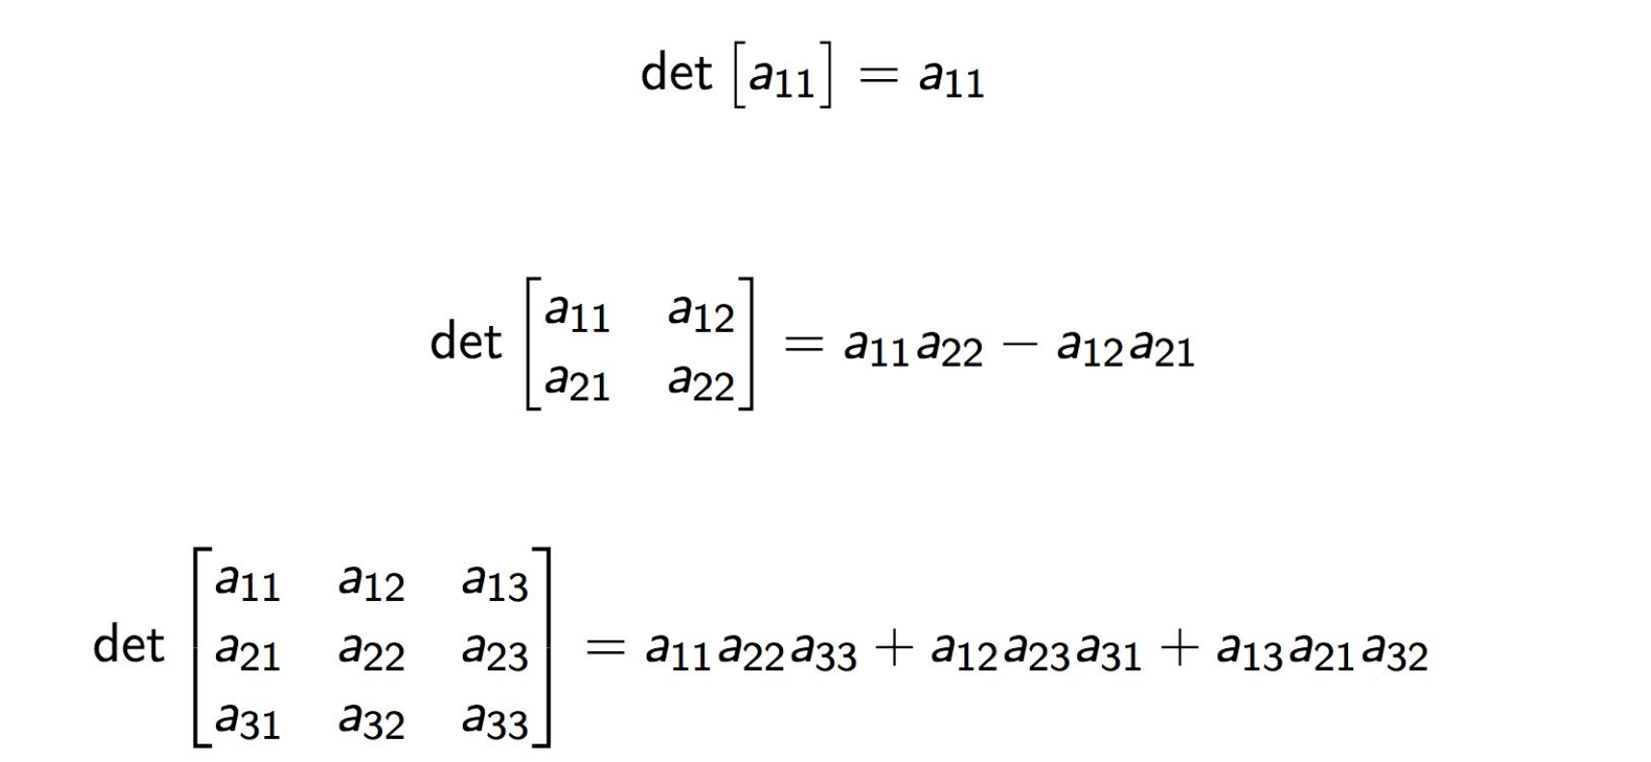

Matrix Determinant
Useful value computed from the elements of a square matrix A

Slide 14
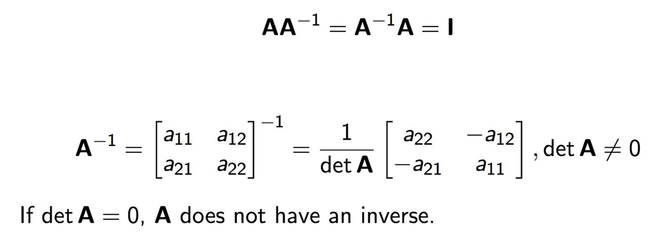
Matrix Inverse
Does not exist for all matrices, necessary (but not sufficient) that the matrix is square

Slide 15
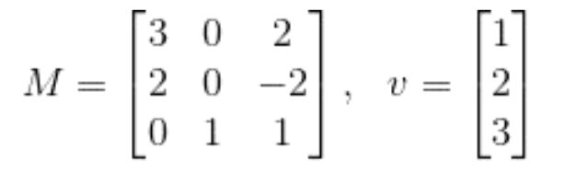
Basic Operations - Determinant and Inverse
print np.linalg.inv(M)
#Output: [[ 0.2 0.2 0. ]
[-0.2 0.3 1. ]
[ 0.2 -0.3 -0. ]]
Be careful of matrices that are not invertible!
print np.linalg.det(M)
#Output: 10.0

Slide 16
SciPy: Linear Algebra
scipy.linalg
SciPy is built using the optimized ATLAS LAPACK (Linear Algebra PACKage) and BLAS (Basic Linear Algebra Subprograms) libraries, it has very fast linear algebra capabilities. All of these linear algebra routines expect an object that can be converted into a 2-dimensional array. The matrix class is initialized with the SciPy command mat which is just convenient short-hand for matrix.
>>> A = matrix('1.0 2.0; 3.0 4.0')
>>> A
[[ 1. 2.]
[ 3. 4.]]
>>> type(A) # file where class is defined
<class 'numpy.matrixlib.defmatrix.matrix'>
>>> B = mat('[1.0 2.0; 3.0 4.0]')
>>> B
[[ 1. 2.]
[ 3. 4.]]
>>> type(B) # file where class is defined
<class 'numpy.matrixlib.defmatrix.matrix'>

Slide 17
SciPy – Linear Algebra
Matrix inversion.
>>> A = mat('[1 3 5; 2 5 1; 2 3 8]')
>>> A
matrix([[1, 3, 5],
[2, 5, 1],
[2, 3, 8]])
>>> A.I
matrix([[-1.48, 0.36, 0.88],
[ 0.56, 0.08, -0.36],
[ 0.16, -0.12, 0.04]])
>>> from scipy import linalg
>>> linalg.inv(A)
array([[-1.48, 0.36, 0.88],
[ 0.56, 0.08, -0.36],
[ 0.16, -0.12, 0.04]])
Notes:
17

Slide 18

SciPy – Linear Algebra
Solving linear system
S = A⁻¹ B where S=[ x y z] and B = [ 10 8 3]
>>> A = mat('[1 3 5; 2 5 1; 2 3 8]')
>>> b = mat('[10;8;3]')
>>> A.I*b
matrix([[-9.28],
[ 5.16],
[ 0.76]])
>>> linalg.solve(A,b)
array([[-9.28],
[ 5.16],
[ 0.76]])
Notes:
18

Slide 19


SciPy – Linear Algebra
Finding Determinant
>>> A = mat('[1 3 5; 2 5 1; 2 3 8]')
>>> linalg.det(A)
-25.000000000000004
Notes:
19

Slide 20
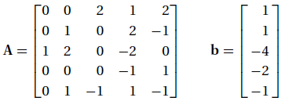


Exercises: Check your answer from Week 4a exercise using Python
Use Gauss elimination to solve the equations Ax = b, where
Use Gauss-Jordan elimination to solve the equations Ax = b, where
Find L and U using Doolittle’s decomposition so that

Slide 21
LU decomposition with Python
L and U is a bit different with numpy
numpy decomposition uses partial pivoting (matrix rows are permuted to use the largest pivot). This is because small pivots can lead to numerical instability.
import numpy as np
import scipy.linalg as la
A = np.array([[1,3,4],[2,1,3],[4,1,2]])
print(A)
P, L, U = la.lu(A)
print(np.dot(P.T, A))
print
print(np.dot(L, U))
print(P)
print(L)
print(U)

Slide 22
Implementation of Doolittle Algorithm in Python
Please visit:
https://www.geeksforgeeks.org/doolittle-algorithm-lu-decomposition/

